Slide 1


Lead Scoring Case Study
Tanvi Joshi

Slide 2

PRIMARY ANALYSIS
Here we observe the missing values in the columns and either delete the columns or impute the data.
We can see that most of the people who have visited the website are from Mumbai, and they are looking to join the course for better career prospects

Slide 3
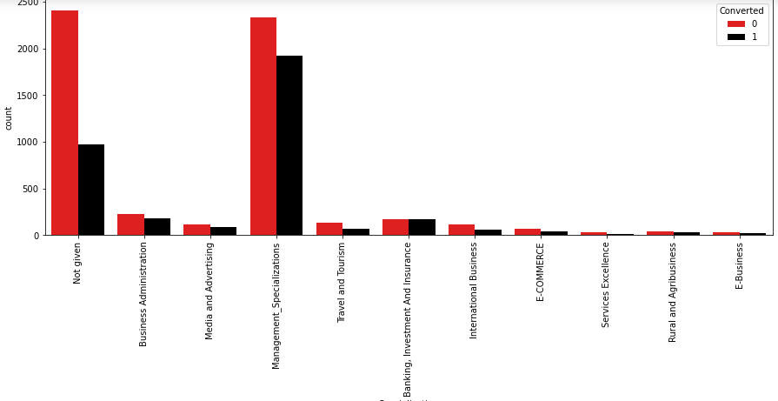
CATEGORIZATION BY SPECIALIZATION
There is a significant difference between the number of people not providing their specializations and those who do.
Maximum people belong to Management Specializations

Slide 4
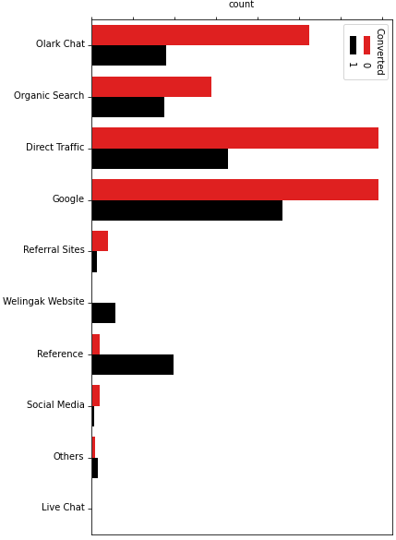
SOURCE OF THE LEAD
Even though the number of people approaching from Olark Chat, Organic search , Direct Traffic and Google is high, but the conversion ratio is less. However people approaching through reference and Wellingak Website have a great conversion ratio.

Slide 5
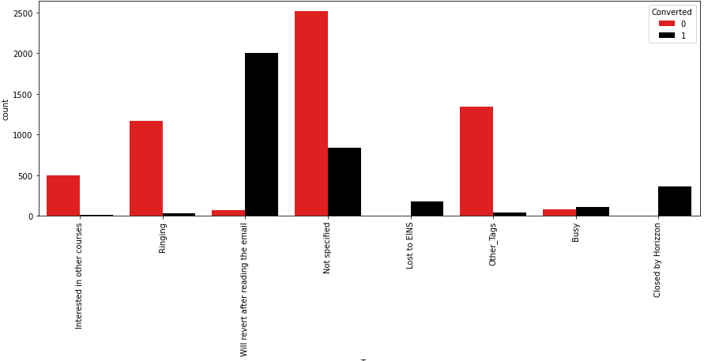
TAGS GIVEN TO LEADS
Most of the leads who have converted are the ones with tags ‘will revert after reading email’ , ‘lost to EINS’ and ‘Closed by Horizzon

Slide 6
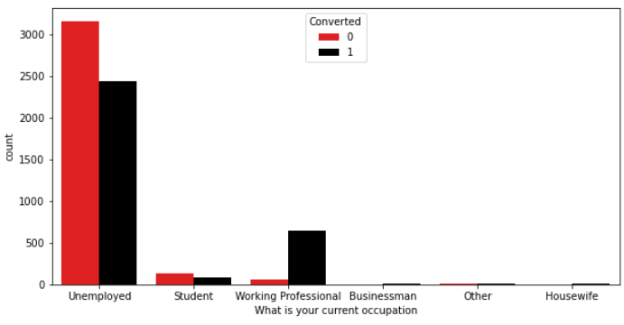
EMPLOYMENT STATUS
We can see a general trend that most of the people visiting the website are unemployed.
We also observe that most of the working professionals have converted.

Slide 7
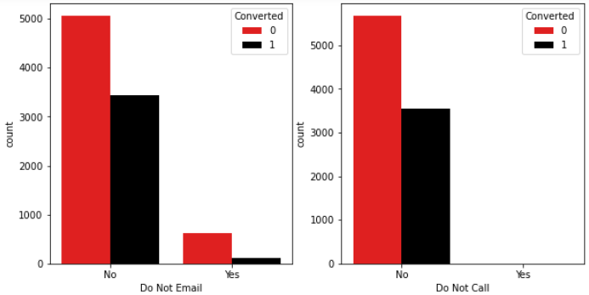
GENERAL OBSERVATIONS
There seems to be no correlation between the number of people converted and the emails or calls that they have requested for. In general, most of the people do not wish to receive calls and only a few people have opted for emails.

Slide 8
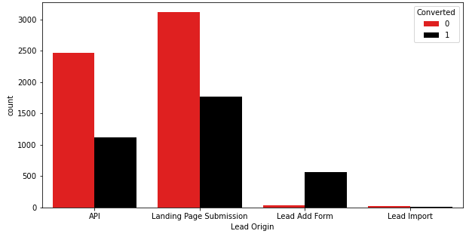
LEAD ORIGIN
The ratio of converted to not converted is highest in Lead Add Form.

Slide 9
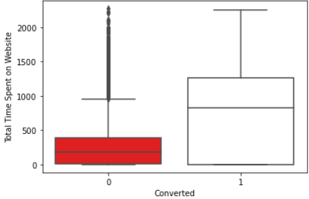
TOTAL TIME SPENT ON WEBSITE
Most of the leads who have converted on average have spent more time on the website and this can be a significant factor to be noted.

Slide 10
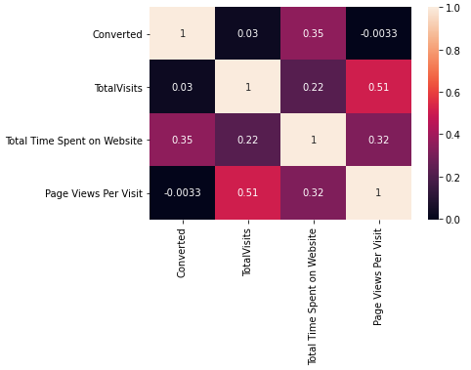
BIVARIATE ANALYSIS
We observe that there is a high correlation between total visits and pages viewed per visit.
Also, leads who spent more time on the website have higher chances of conversion

Slide 11
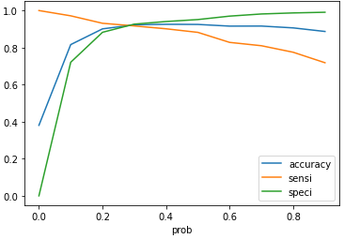
THRESHOLD FOR PREDICTION
As observed from the graph , to maintain a tradeoff between the specificity, sensitivity and accuracy of the model, we set the threshold to 0.3 to achieve optimum results for predicted values.

Slide 12
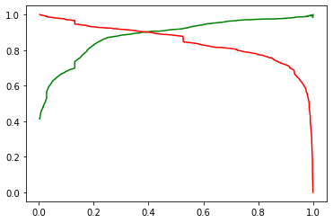
THRESHOLD FOR PREDICTION
As observed from the graph , to maintain a tradeoff between the precision and recall of the model, we set the threshold to 0.4

Slide 13
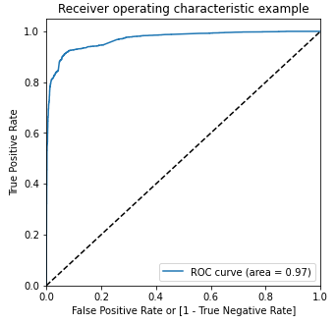
TESTING THE MODEL
Accuracy achieved is 92%
Sensitivity is 91%
Specificity is 93%
Total Number of conversion are 38%. And due to high sensitivity, we can capture almost 36% of the potential leads.

Slide 14
RESULTS OBTAINED
The Sales team should focus on working professionals and housewives and unemployed people. It would save time not to focus on business men, and No services excellence people.
As most of the leads belong to Mumbai , it would not be worth the effort to differentiates based on geography among the leads.
It is very important to focus on leads who have come through reference or from welingak website.
If the total time spent is more than 1000. If the time spent is less than 250 , the lead need not be pursued immediately.
Team should highly focus on the lead when the lead origin is Lead Add Form.
It is important to note that higher number of conversions are through direct traffic.

Slide 15

THANK YOU
This case study was performed using Python and its libraries.
Extensive Analysis was performed to derive better business insights on the goal to be achieved.

